Slide 1
HISTORY OF ASL

Slide 2
Some of this may be new. You won’t need to know all of this, but you need to go through it to have the basic understanding of how we got to where we are today.

Slide 3
How the Deaf were viewed.
Aristotle & Plato Times (400-300 BC)
• They believed all intelligence was
present at birth.
• Without speech there was no outward sign of intelligence, so Deaf people must not be capable of ideas or language.
The Deaf were called
DEAF & DUMB
Notes:
This was the philosophy of the time…this is what people thought.

Slide 4
During the Dark and Middle Ages
Deaf people were committed to asylums because of their speech and behavior - many thought to be possessed by demons
Another belief was that one must be able to "hear" the word of God –
Punishment from God

Slide 5
First Known Attempts at Educating the Deaf 1500’s
Pedro Ponce de Leon, a Benedictine Monk
To communicate necessary information, they develop their own form of sign language for their “vow of silence”
These signs may have been used later in attempts to teach Deaf children
He taught deaf sons of the Spanish nobility in order that they might inherit property.
Note: Back in the day you couldn’t inherit property if you were not educated.
Notes:
NOTE TAKE STARTS HERE!

Slide 6
MARTHA’S VINEYARD
It is an island off the coast of Massachusetts
Settled by 200 immigrants from Kent County England.
Carried dominant and recessive genes for deafness.
By the mid-1700's a sign language (not ASL, it was not invented yet) had developed on the island, used by deaf and hearing islanders alike.
Almost all inhabitants signed and town meetings were signed for all.
Deaf islanders married, had families, worked, voted, held public office and were equal.

Slide 7
EARLY 1800’s
Laurent Clerc
Born in 1785 in France
He was born hearing.
He became deaf after falling from his high chair into the kitchen fireplace. His right cheek was severely burned and a fever developed.
Was uneducated until the age of 12.
Went to the Institut National des Jeune Sourds-Muets, located in Paris, France - the first public school for the deaf in the world
Later he became the first Deaf teacher in the United States and later known as “Father of the Deaf”

Slide 8
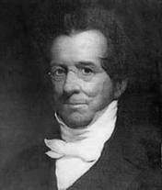
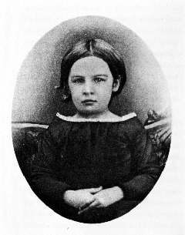
How ASL began?
Thomas Gallaudet’s was a minister and a neighbors
of the Cogswell’s
They had a daughter, Alice. She was deaf and unable to
read and write.
Gallaudet was asked by Mr. Cogswell if he would
go to Europe to see how they were teaching deaf children.
He went to France and observed the National Royal Institute for the Deaf and met Laurent Clerc.

Slide 9
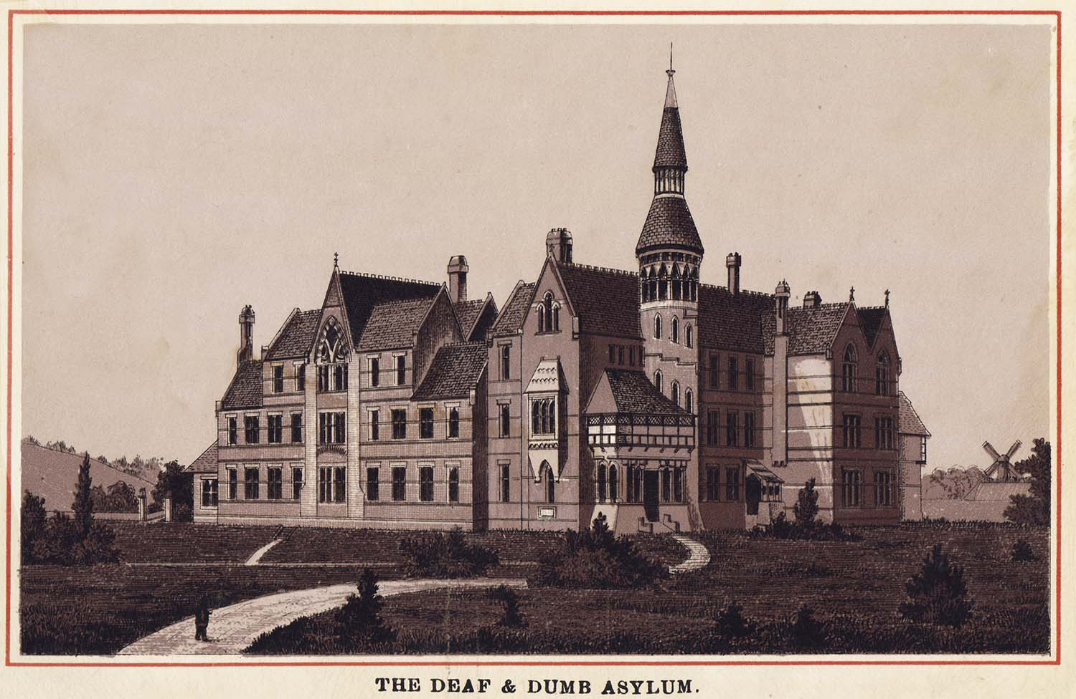
Thomas Gallaudet invited Laurent Clerc
to come to America and help
start a school for the Deaf.
Clerc accepted.
Laurent Clerc and Thomas Gallaudet traveled across the Atlantic Ocean (52 day journey back then) teaching each other; Clerc – English, Gallaudet – Sign Language.
They began the Connecticut Asylum for the Education and Instruction of Deaf and Dumb Persons – officially opening in 1817.

Slide 10
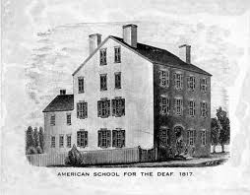
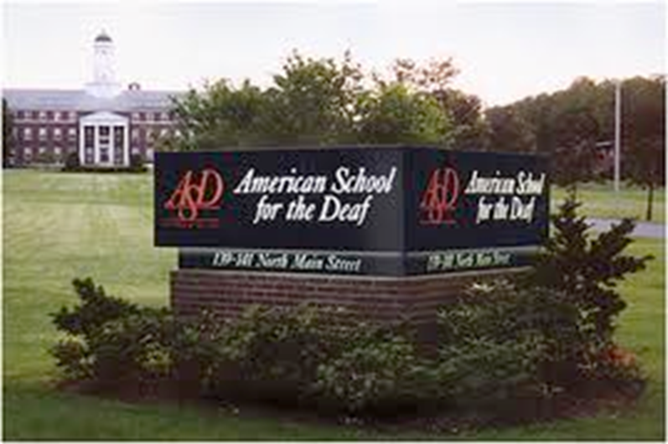
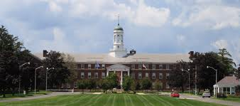
Gallaudet & Clerc
Now it is known as American School for the Deaf.
Located in Hartford, Connecticut

Slide 11
The term Deaf-Mute was beginning to be used instead of Deaf and Dumb because the deaf were now being educated.

Slide 12
Other Figures in Deaf History

Slide 13
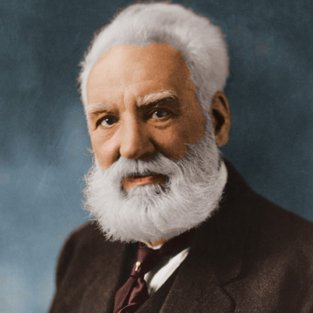
Late 1800’s
Alexander Graham Bell
A hearing inventor that married a deaf woman.
His wife became deaf at the age of 5.
His mother also had a hearing loss.
He was an oralist – believing oral skills were essential to socializing and developing.
He also believed in eugenic - the science of improving a human population by controlled breeding to increase the occurrence of desirable heritable characteristics.
A.G. Bell believe Deaf people should not marrying each other, stopping the spread of a bad trait.
What other famous person in history believed in Eugenics?
HITLER!!!!
*YES, he did invent the telephone but that was not a contribution to Deaf History.
Notes:
His father invented “visible speech”
Eugenics - improvement by human mating.

Slide 14
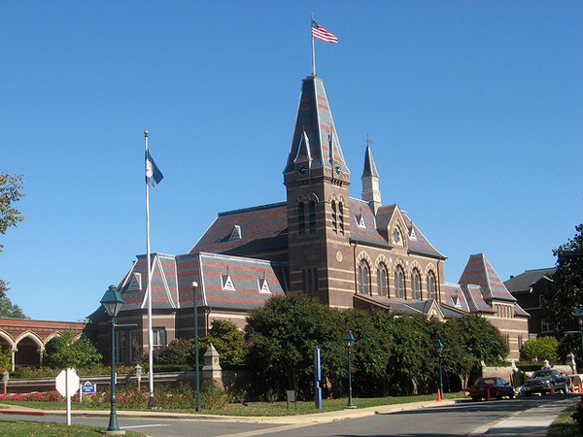
Gallaudet University
Located in the heart of Washington DC
In 1856, the school (not university yet)
was first established for 12 deaf and 6
blind students.
In 1864 Congress authorized the school to award college degrees and President Lincoln sign the bill into law.
The school name was changed from Columbia Institution for the Instruction of the Deaf and Dumb and Blind – but went through several name changes before being changes to in 1986 to Gallaudet University in honor of Thomas Hopkins Gallaudet.
Notes:
Tip for students: Remember LINCOLN signed it into law – LINCOLN was PRESIDENT of US in WASHINGTON D.C.

Slide 15
Gallaudet University
IMPORTANT!!!! Gallaudet University was NOT the first school for the Deaf!
GU was established in
ASD was established in
1856
1817

Slide 16
KNOW THE DIFFERENCE!
Gallaudet University and American School for the Deaf are TWO DIFFERENT SCHOOLS!
Gallaudet is located in Washington DC
Started as a school but is now University
NOT Established by Gallaudet – just named in his honor!
American School for the Deaf is in Hartsford, Connecticut
It is a school (K-12)
Established by Gallaudet and Clerc

Slide 17
The NAD
National Association of the Deaf
Established in 1880
It is the “nation's premier civil rights organization of, by and for deaf and hard of hearing individuals in the United States of America.” www.nad.org

Slide 18
The NAD has helped change to terms from Deaf and Dumb, and Deaf-Mute to the once accepted Handicap and Hearing-Impaired.
Now the appropriate terms are Deaf or Hard of Hearing.

Slide 19
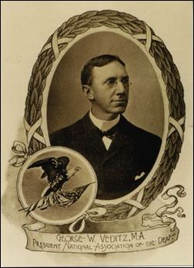
EARLY 1900’s
George Veditz
7th President of National Association for
the Deaf also known as the NAD.
Became Deaf at 8 years old.
He was the first to used films to preserve sign language, “As long as there are Deaf people, there is sign language.”
http://www.youtube.com/watch?v=XITbj3NTLUQ&safety_mode=true&persist_safety_mode=1&safe=active

Slide 20
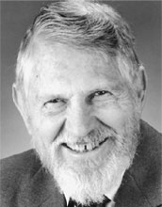
1960’s
William Stokoe
Hearing professor at Gallaudet University
After many years of hard work he proved ASL to be a true language. (To the right on your paper is his work proving ASL to be it’s own unique language, not just gestures)
He published the 1st ASL Dictionary.
You can thank HIM for being in this class
and not taking Spanish or French!

Slide 21
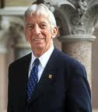
I King Jordan
BIG, BIG Deal!!!
1st Deaf president at Gallaudet University
He became president after the Deaf President Now movement in 1988
Became Deaf at the age of 21
Famous quote,
“Deaf people can do anything… but hear.”

Slide 22
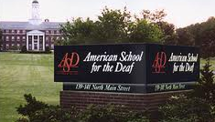
REVIEW
What is the name of the first School for the Deaf in America?
Where is it located?
Hartsford, Ct
When was
it established?
1817
Who founded this
school?
Gallaudet and Clerc

Slide 23
Who was the first deaf president at Gallaudet University?
Where is Gallaudet University?
Who helped prove ASL is a true language?
Who is believed for first develop sign language?
I. King Jordan
Washington DC
William Stokoe
A monk, Pedro Ponce de Leon

