Slide 1
Anatomy of the Ear
Parts of the Ear
Notes:
Minimum time needed 12 minutes

Slide 2
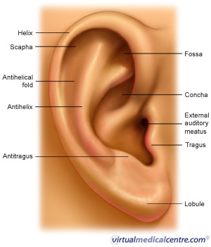
Is this your ear?

Slide 3
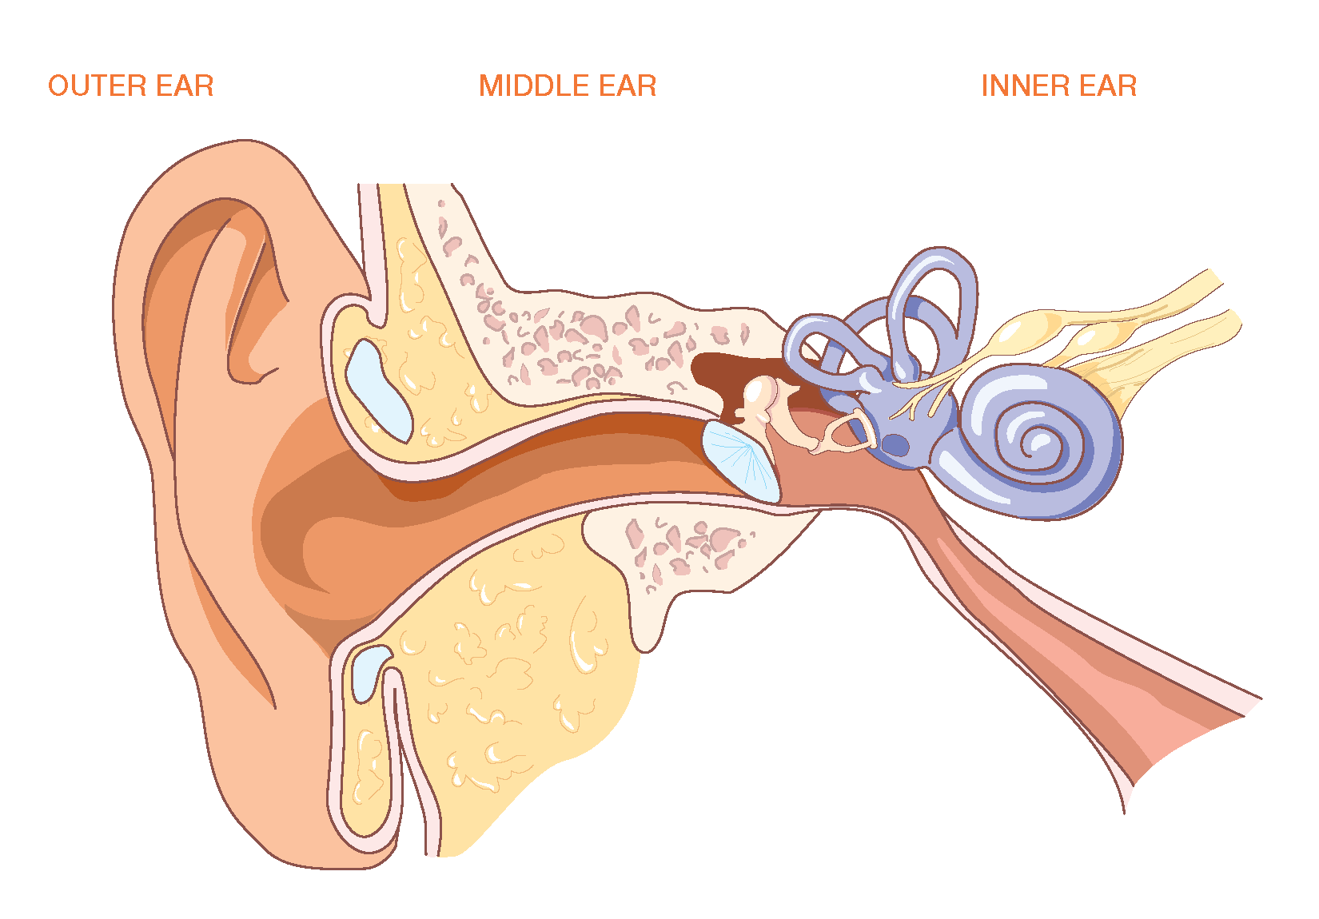
NOPE – This is the Ear!
Notes:
Minimum time needed 12 minutes

Slide 4
There are three sections of the ear!
INNER | MIDDLE | OUTER
We are actually going to go backwards – start in the outer part of the ear.
Notes:
Minimum time needed 12 minutes

Slide 5
Outer Ear
Pinna -also known as the Auricle
Ear Canal or External Auditory Canal

Slide 6
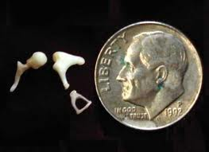
Middle Ear
Tympanic Membrane - Ear Drum
Eustachian Tube
Three Bones known as the Ossicular Chain
Malleus
Incus
Stapes

Slide 7
Inner Ear
Semicircular canals
Cochlea
Organ of Corti
3 Chambers
2 Membranes
Notes:
Minimum time needed 12 minutes

Slide 8
You will be expected to label the parts of the ear. Start studying NOW!

Slide 9
Can you identify/label the parts of the ear?

Slide 11
Notes:
Minimum time needed 12 minutes

